Slide 1

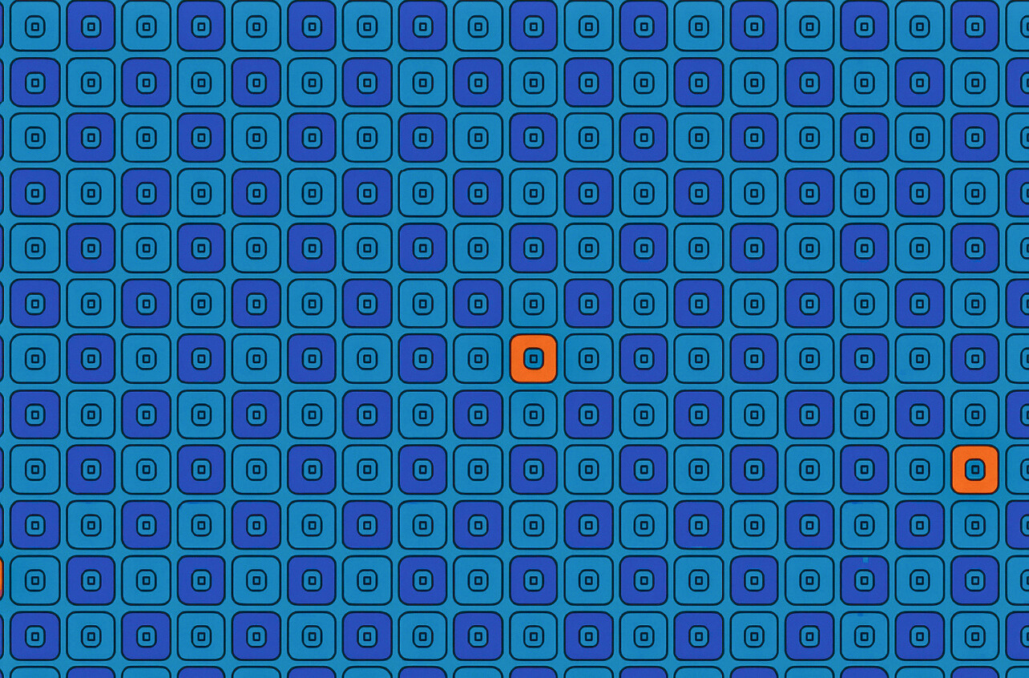







3RD COLORADO PSYCHEDELIC CUP AWARDS

Slide 2



COMPETITION OVERVIEW
Overview of Data
2025 Champions
  Cacti Biomass & Extracts
  DMT Extracts
  Mushroom Fruit & Extracts
  Mushroom Edible Products
Total Samples:
270+ Samples
Participants:
84 Participants
2026 Data Collection Already Underway

Slide 3



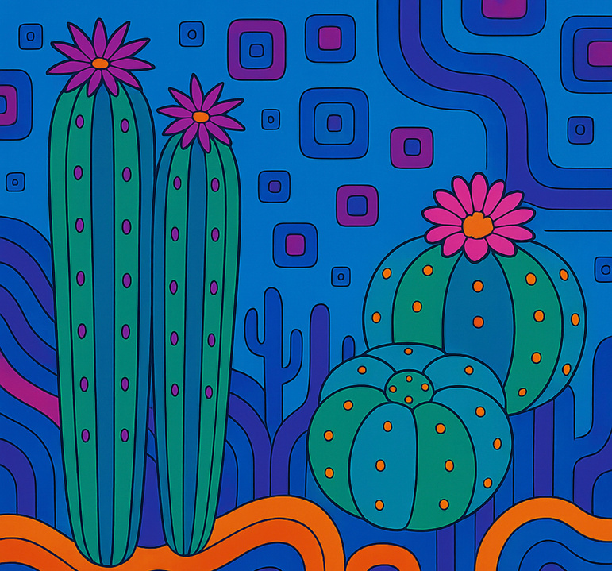
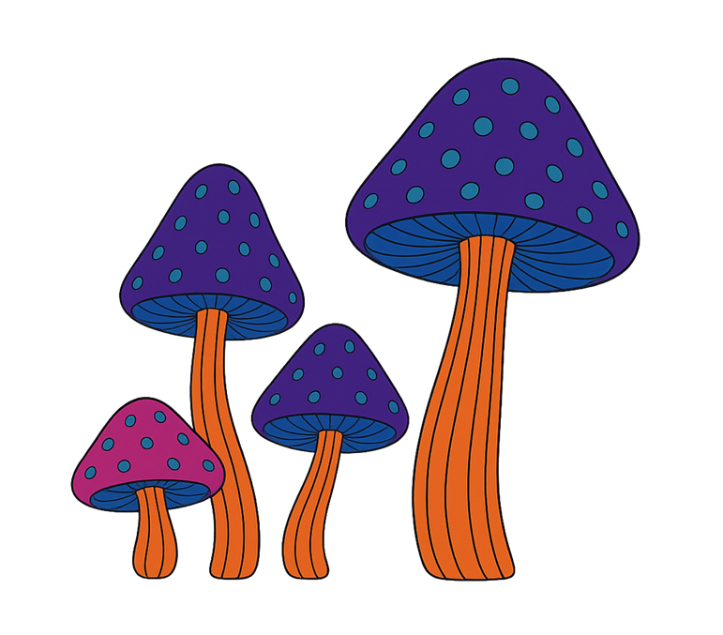

CACTI COMPETITION
CACTI COMPETITON
Overview of Data
Improvements For Next Year
Overview of Data
Highlights
Total Samples:
8 Biomass, 2 Extracts
Range of Potency:
MESC: 0.12 - 22.5 mg/g
64-71% Purity Extract
Potency Difference:
1g = 187g
Total Samples:
16 Biomass
4 Extracts
Potency Range:
0.08-32.4 mg/g
Sampling Protocol Updates
Whole Cacti or Powdered?
Age of Samples
One of the Largest Tested Species Databases
A New Psychedelic Cacti Species
Hordineine Dominant Cacti

Slide 4






BIOMASS CHAMPIONS
1ST PLACE
2ND PLACE
3RD PLACE

Slide 5
BIOMASS CHAMPIONS
1ST PLACE
2ND PLACE
3RD PLACE
Grower ID:
10625
Sample Name:
T. scopolocula
Potency Preview:
MESC: 15.06 mg/g

Slide 6
BIOMASS CHAMPIONS
1ST PLACE
2ND PLACE
3RD PLACE
Grower ID:
10625
Sample Name:
"Penis plant" (TBM)
Potency Preview:
MESC: 18.38 mg/g
Grower ID:
10625
Sample Name:
T. scopolocula
Potency Preview:
MESC: 15.06 mg/g

Slide 7
BIOMASS CHAMPIONS
1ST PLACE
Grower ID:
10625
Sample Name:
T. bridgesii
Potency Preview:
MESC: 32.41 mg/g
2ND PLACE
3RD PLACE
Grower ID:
10625
Sample Name:
"Penis plant" (TBM)
Potency Preview:
MESC: 18.38 mg/g
Grower ID:
10625
Sample Name:
T. scopolocula
Potency Preview:
MESC: 15.06 mg/g

Slide 8
EXTRACT CHAMPIONS
1ST PLACE
2ND PLACE
3RD PLACE

Slide 9
EXTRACT CHAMPIONS
1ST PLACE
2ND PLACE
3RD PLACE
Grower ID:
10528
Sample Name:
Extract
Potency Preview:
MESC: 8.77 mg/g

Slide 10
EXTRACT CHAMPIONS
1ST PLACE
2ND PLACE
3RD PLACE
Grower ID:
34252
Sample Name:
Peruvian San Pedro
Potency Preview:
MESC: 11.56 mg/ml
Grower ID:
10528
Sample Name:
Extract
Potency Preview:
MESC: 8.77 mg/g

Slide 11
EXTRACT CHAMPIONS
1ST PLACE
Grower ID:
27161
Sample Name:
SP-Isolate-01
Potency Preview:
MESC: 715.14 mg/g
2ND PLACE
3RD PLACE
Grower ID:
34252
Sample Name:
Peruvian San Pedro
Potency Preview:
MESC: 11.56 mg/ml
Grower ID:
10528
Sample Name:
Extract
Potency Preview:
MESC: 8.77 mg/g

Slide 12
CACTI COMPETITION
DMT COMPETITON
Overview of Data
Improvements For Next Year
Overview of Data
Highlights
Total Samples:
8 Biomass, 2 Extracts
Range of Potency:
MESC: 0.12 - 22.5 mg/g
64-71% Purity Extract
Potency Difference:
1g = 187g
Total Samples:
5 Bark Samples
2 5-MeO-DMT
12 N,N-DMT Samples
Potency Range:
Bark: 1.1-3.3 %
Extract: 36-99%
Sampling Protocol Updates
Whole Cacti or Powdered?
Age of Samples
5-MeO-Samples Included
Nearly 100% Pure Compounds Tested This Year
3x Difference in Where You Buy Your Bark

Slide 13

BIOMASS CHAMPIONS
1ST PLACE
2ND PLACE
3RD PLACE

Slide 14
BIOMASS CHAMPIONS
1ST PLACE
2ND PLACE
3RD PLACE
Grower ID:
33221
Sample Name:
MimosaHostilis.shop
Potency Preview:
N,N-DMT: 26.45 mg/g

Slide 15
BIOMASS CHAMPIONS
1ST PLACE
2ND PLACE
3RD PLACE
Grower ID:
33221
Sample Name:
Fayetteville Herb CO 2023
Potency Preview:
N,N-DMT: 26.97 mg/g
Grower ID:
33221
Sample Name:
MimosaHostilis.shop
Potency Preview:
N,N-DMT: 26.45 mg/g

Slide 16
BIOMASS CHAMPIONS
1ST PLACE
Grower ID:
33221
Sample Name:
PrimeBark
Potency Preview:
N,N-DMT: 33.13 mg/g
2ND PLACE
3RD PLACE
Grower ID:
33221
Sample Name:
Fayetteville Herb CO 2023
Potency Preview:
N,N-DMT: 26.97 mg/g
Grower ID:
33221
Sample Name:
MimosaHostilis.shop
Potency Preview:
N,N-DMT: 26.45 mg/g

Slide 17
EXTRACT CHAMPIONS
1ST PLACE
2ND PLACE
3RD PLACE

Slide 18
EXTRACT CHAMPIONS
1ST PLACE
2ND PLACE
3RD PLACE
Grower ID:
10623
Sample Name:
AC-F-X
Potency Preview:
N,N-DMT: 983.25 mg/g
(98.33% Purity)

Slide 19
EXTRACT CHAMPIONS
1ST PLACE
2ND PLACE
3RD PLACE
Grower ID:
10623
Sample Name:
V-V,MH
Potency Preview:
N,N-DMT: 989.72 mg/g (98.97% Purity)
Grower ID:
10623
Sample Name:
AC-F-X
Potency Preview:
N,N-DMT: 983.25 mg/g
(98.33% Purity)

Slide 20
EXTRACT CHAMPIONS
1ST PLACE
Grower ID:
27161
Sample Name:
MHRB-V2
Potency Preview:
N,N-DMT: 997.02 mg/g
(99.70% Purity)
2ND PLACE
3RD PLACE
Grower ID:
10623
Sample Name:
V-V,MH
Potency Preview:
N,N-DMT: 989.72 mg/g (98.97% Purity)
Grower ID:
10623
Sample Name:
AC-F-X
Potency Preview:
N,N-DMT: 983.25 mg/g
(98.33% Purity)

Slide 21
HIGHEST TOTAL ACTIVES
1ST PLACE
2ND PLACE
3RD PLACE

Slide 22
HIGHEST TOTAL ACTIVES
1ST PLACE
2ND PLACE
3RD PLACE
Grower ID:
10623
Sample Name:
V-V,MH
Potency Preview:
994.32 mg/g

Slide 23
HIGHEST TOTAL ACTIVES
1ST PLACE
2ND PLACE
3RD PLACE
Grower ID:
10472
Sample Name:
5-MeO-DMT Freebase Re-X
Potency Preview:
994.89 mg/g
Grower ID:
10623
Sample Name:
V-V,MH
Potency Preview:
994.32 mg/g

Slide 24
HIGHEST TOTAL ACTIVES
1ST PLACE
Grower ID:
27161
Sample Name:
MHRB-V2
Potency Preview:
999.35 mg/g
2ND PLACE
3RD PLACE
Grower ID:
10472
Sample Name:
5-MeO-DMT Freebase Re-X
Potency Preview:
994.89 mg/g
Grower ID:
10623
Sample Name:
V-V,MH
Potency Preview:
994.32 mg/g

Slide 25
CACTI COMPETITION
EDIBLE COMPETITON
Overview of Data
Improvements For Next Year
Overview of Data
Highlights
Total Samples:
8 Biomass, 2 Extracts
Range of Potency:
MESC: 0.12 - 22.5 mg/g
64-71% Purity Extract
Potency Difference:
1g = 187g
Total Samples:
44 Edibles
Potency Range:
0.1-10 mg/serving
0.25-50 mg/package
Sampling Protocol Updates
Whole Cacti or Powdered?
Age of Samples
15% Variance Pass/Fail
6 of 44 Failed
7 Samples with Less Than 1% Variance

Slide 26

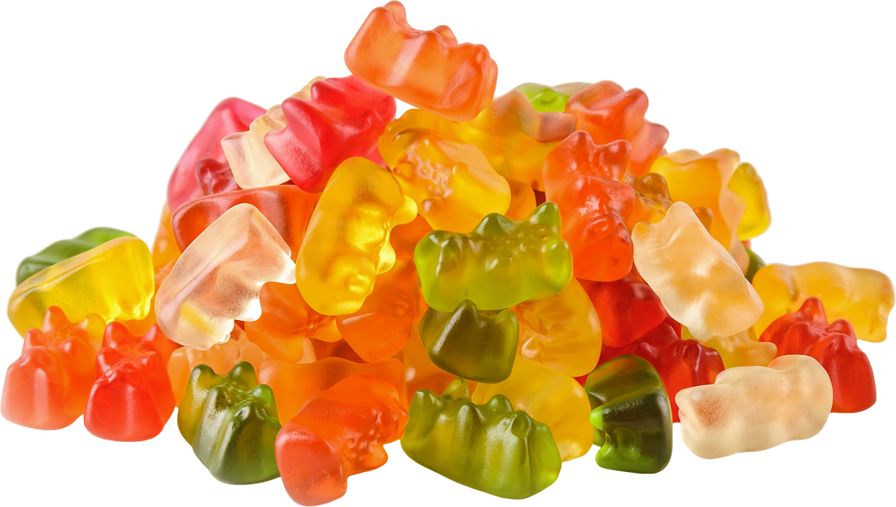
MOST HOMOGENEOUS
1ST PLACE
2ND PLACE
3RD PLACE

Slide 27
MOST HOMOGENEOUS
1ST PLACE
2ND PLACE
3RD PLACE
Grower ID:
10475
Sample Name:
Electrolyte drink mix
Potency Preview:
PsilcinEQ RSD: 0.56%

Slide 28
MOST HOMOGENEOUS
1ST PLACE
2ND PLACE
3RD PLACE
Grower ID:
32348
Sample Name:
Microdose Gummies- Grapefruit 8/22
Potency Preview:
PsilocinEQ RSD: 0.48%
Grower ID:
10475
Sample Name:
Electrolyte drink mix
Potency Preview:
PsilcinEQ RSD: 0.56%

Slide 29
MOST HOMOGENEOUS
1ST PLACE
Grower ID:
32348
Sample Name:
Vizion Bar- Enigma + Truffle + Shakti + Hillbilly Pumpkin
Potency Preview:
PsilocinEQ RSD: 0.31%
2ND PLACE
3RD PLACE
Grower ID:
32348
Sample Name:
Microdose Gummies- Grapefruit 8/22
Potency Preview:
PsilocinEQ RSD: 0.48%
Grower ID:
10475
Sample Name:
Electrolyte drink mix
Potency Preview:
PsilcinEQ RSD: 0.56%

Slide 30
CACTI COMPETITION
MUSHROOM COMPETITON
Overview of Data
Improvements For Next Year
Overview of Data
Highlights
Total Samples:
8 Biomass, 2 Extracts
Range of Potency:
MESC: 0.12 - 22.5 mg/g
64-71% Purity Extract
Potency Difference:
1g = 187g
Total Samples:
175 Fruit Samples
18 Mushroom Extract
Potency Range:
Extract: 1.3 - 138 mg/g
Fruit: 0.7 - 35 mg/g
Sampling Protocol Updates
Whole Cacti or Powdered?
Age of Samples
New Exotic Species
Over 10% Extract
20 Samples Over 2%

Slide 31
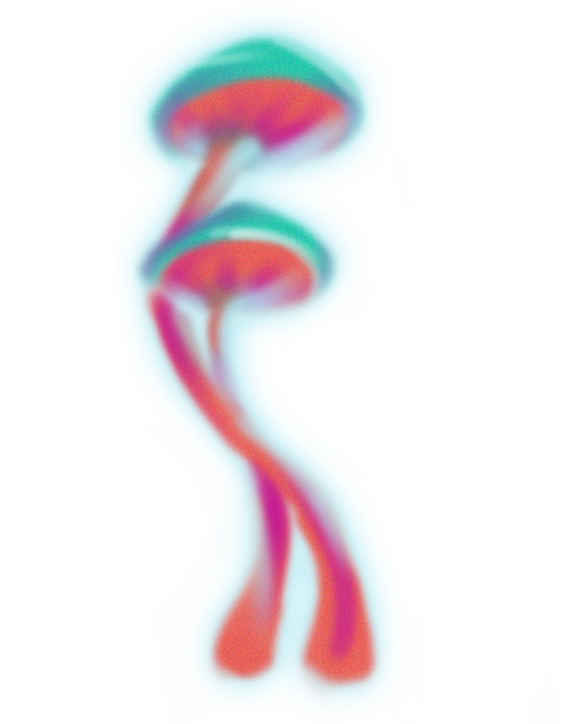
MOST PURE EXTRACT
1ST PLACE
2ND PLACE
3RD PLACE

Slide 32
MOST PURE EXTRACT
1ST PLACE
2ND PLACE
3RD PLACE
Grower ID:
33425
Sample Name:
250721
Potency Preview:
PCN EQ: 26.05 mg/g

Slide 33
MOST PURE EXTRACT
1ST PLACE
2ND PLACE
3RD PLACE
Grower ID:
33425
Sample Name:
20250915
Potency Preview:
PCN EQ: 29.48 mg/g
Grower ID:
33425
Sample Name:
250721
Potency Preview:
PCN EQ: 26.05 mg/g

Slide 34
MOST PURE EXTRACT
1ST PLACE
Grower ID:
10627
Sample Name:
Panaeolus cyanescens "M.I.B"
Potency Preview:
PCN EQ: 138.43 mg/g
Total Actives: 176.25 mg/g
2ND PLACE
3RD PLACE
Grower ID:
33425
Sample Name:
20250915
Potency Preview:
PCN EQ: 29.48 mg/g
Grower ID:
33425
Sample Name:
250721
Potency Preview:
PCN EQ: 26.05 mg/g

Slide 35
LOWEST PSILOCIN EQ
1ST PLACE
2ND PLACE
3RD PLACE

Slide 36
LOWEST PSILOCIN EQ
1ST PLACE
2ND PLACE
3RD PLACE
Grower ID:
10593
Sample Name:
Ps. galindoi
Potency Preview:
PCN EQ: 1.35 mg/g

Slide 37
LOWEST PSILOCIN EQ
1ST PLACE
2ND PLACE
3RD PLACE
Grower ID:
26804
Sample Name:
galindoi Sclerotia
Potency Preview:
PCN EQ: 0.76 mg/g
Grower ID:
10593
Sample Name:
Ps. galindoi
Potency Preview:
PCN EQ: 1.35 mg/g

Slide 38
LOWEST PSILOCIN EQ
1ST PLACE
Grower ID:
10573
Sample Name:
Psilocybe tampanensis Sclerotia
Potency Preview:
PCN EQ: 0.71 mg/g
2ND PLACE
3RD PLACE
Grower ID:
26804
Sample Name:
galindoi Sclerotia
Potency Preview:
PCN EQ: 0.76 mg/g
Grower ID:
10593
Sample Name:
Ps. galindoi
Potency Preview:
PCN EQ: 1.35 mg/g

Slide 39
HIGHEST BAEOCYSTIN (CUBES)
1ST PLACE
2ND PLACE
3RD PLACE

Slide 40
HIGHEST BAEOCYSTIN (CUBES)
1ST PLACE
2ND PLACE
3RD PLACE
Grower ID:
25288
Sample Name:
Starry Night "Thunder Clouds"
Potency Preview:
BAEO: 0.65 mg/g

Slide 41
HIGHEST BAEOCYSTIN (CUBES)
1ST PLACE
2ND PLACE
3RD PLACE
Grower ID:
10654
Sample Name:
Starry Night APE
Potency Preview:
BAEO: 0.81 mg/g
Grower ID:
25288
Sample Name:
Starry Night "Thunder Clouds"
Potency Preview:
BAEO: 0.65 mg/g

Slide 42
HIGHEST BAEOCYSTIN (CUBES)
1ST PLACE
Grower ID:
32005
Sample Name:
Humble A.P.E
Potency Preview:
BAEO: 1.02 mg/g
2ND PLACE
3RD PLACE
Grower ID:
10654
Sample Name:
Starry Night APE
Potency Preview:
BAEO: 0.81 mg/g
Grower ID:
25288
Sample Name:
Starry Night "Thunder Clouds"
Potency Preview:
BAEO: 0.65 mg/g

Slide 43
HIGHEST BAEOCYSTIN (EXOTICS)
1ST PLACE
2ND PLACE
3RD PLACE

Slide 44
HIGHEST BAEOCYSTIN (EXOTICS)
1ST PLACE
2ND PLACE
3RD PLACE
Grower ID:
33237
Sample Name:
Ps. semperviva
Potency Preview:
BAEO: 1.76 mg/g

Slide 45
HIGHEST BAEOCYSTIN (EXOTICS)
1ST PLACE
2ND PLACE
3RD PLACE
Grower ID:
10413
Sample Name:
Psilocybe subtropicalis, Coyopolan, F1
Potency Preview:
BAEO: 2.23 mg/g
Grower ID:
33237
Sample Name:
Ps. semperviva
Potency Preview:
BAEO: 1.76 mg/g

Slide 46
HIGHEST BAEOCYSTIN (EXOTICS)
1ST PLACE
Grower ID:
10413
Sample Name:
Ps. ingeli Harding, South Africa F2
Potency Preview:
BAEO: 2.46 mg/g
2ND PLACE
3RD PLACE
Grower ID:
10413
Sample Name:
Psilocybe subtropicalis, Coyopolan, F1
Potency Preview:
BAEO: 2.23 mg/g
Grower ID:
33237
Sample Name:
Ps. semperviva
Potency Preview:
BAEO: 1.76 mg/g

Slide 47
HIGHEST NORBAEOCYSTIN (CUBES)
1ST PLACE
2ND PLACE
3RD PLACE

Slide 48
HIGHEST NORBAEOCYSTIN (CUBES)
1ST PLACE
2ND PLACE
3RD PLACE
Grower ID:
33217
Sample Name:
Nutcracker "Sea Anemone" Mutation
Potency Preview:
NORB: 0.15 mg/g

Slide 49
HIGHEST NORBAEOCYSTIN (CUBES)
1ST PLACE
2ND PLACE
3RD PLACE
Grower ID:
32005
Sample Name:
Humble A.P.E
Potency Preview:
NORB: 0.21 mg/g
Grower ID:
33217
Sample Name:
Nutcracker "Sea Anemone" Mutation
Potency Preview:
NORB: 0.15 mg/g

Slide 50
HIGHEST NORBAEOCYSTIN (CUBES)
1ST PLACE
Grower ID:
25288
Sample Name:
Starry Night "Thunder Clouds"
Potency Preview:
NORB: 0.23 mg/g
2ND PLACE
3RD PLACE
Grower ID:
32005
Sample Name:
Humble A.P.E
Potency Preview:
NORB: 0.21 mg/g
Grower ID:
33217
Sample Name:
Nutcracker "Sea Anemone" Mutation
Potency Preview:
NORB: 0.15 mg/g

Slide 51
HIGHEST NORBAEOCYSTIN (EXOTICS)
1ST PLACE
2ND PLACE
3RD PLACE

Slide 52
HIGHEST NORBAEOCYSTIN (EXOTICS)
1ST PLACE
2ND PLACE
3RD PLACE
Grower ID:
10413
Sample Name:
Psilocybe subtropicalis, Coyopolan, F1
Potency Preview:
NORB: 0.312 mg/g

Slide 53
HIGHEST NORBAEOCYSTIN (EXOTICS)
1ST PLACE
2ND PLACE
3RD PLACE
Grower ID:
10623
Sample Name:
P. ovoideocystidiata Batch #130525
Potency Preview:
NORB: 0.317 mg/g
Grower ID:
10413
Sample Name:
Psilocybe subtropicalis, Coyopolan, F1
Potency Preview:
NORB: 0.312 mg/g

Slide 54
HIGHEST NORBAEOCYSTIN (EXOTICS)
1ST PLACE
Grower ID:
10413
Sample Name:
Ps. ingeli Harding, South Africa F2
Potency Preview:
NORB: 0.504 mg/g
2ND PLACE
3RD PLACE
Grower ID:
10623
Sample Name:
P. ovoideocystidiata Batch #130525
Potency Preview:
NORB: 0.317 mg/g
Grower ID:
10413
Sample Name:
Psilocybe subtropicalis, Coyopolan, F1
Potency Preview:
NORB: 0.312 mg/g

Slide 55
HIGHEST NORPSILOCIN (CUBES)
1ST PLACE
2ND PLACE
3RD PLACE

Slide 56
HIGHEST NORPSILOCIN (CUBES)
1ST PLACE
2ND PLACE
3RD PLACE
Grower ID:
10540
Sample Name:
Remnant
Potency Preview:
NORP: 0.077 mg/g

Slide 57
HIGHEST NORPSILOCIN (CUBES)
1ST PLACE
2ND PLACE
3RD PLACE
Grower ID:
10441
Sample Name:
Steel Yeti SY03 Mutant
Potency Preview:
NORP: 0.079 mg/g
Grower ID:
10540
Sample Name:
Remnant
Potency Preview:
NORP: 0.077 mg/g

Slide 58
HIGHEST NORPSILOCIN (CUBES)
1ST PLACE
Grower ID:
10656
Sample Name:
Krishna
Potency Preview:
NORP: 0.100 mg/g
2ND PLACE
3RD PLACE
Grower ID:
10441
Sample Name:
Steel Yeti SY03 Mutant
Potency Preview:
NORP: 0.079 mg/g
Grower ID:
10540
Sample Name:
Remnant
Potency Preview:
NORP: 0.077 mg/g

Slide 59
HIGHEST NORPSILOCIN (EXOTICS)
1ST PLACE
2ND PLACE
3RD PLACE

Slide 60
HIGHEST NORPSILOCIN (EXOTICS)
1ST PLACE
2ND PLACE
3RD PLACE
Grower ID:
10472
Sample Name:
Psilocybe zapotecorum Encinal 2 x Cinco Palos
Potency Preview:
NORP: 0.48 mg/g

Slide 61
HIGHEST NORPSILOCIN (EXOTICS)
1ST PLACE
2ND PLACE
3RD PLACE
Grower ID:
23728
Sample Name:
TTBVI REDSPORE #2
Potency Preview:
NORP: 0.49 mg/g
Grower ID:
10472
Sample Name:
Psilocybe zapotecorum Encinal 2 x Cinco Palos
Potency Preview:
NORP: 0.48 mg/g

Slide 62
HIGHEST NORPSILOCIN (EXOTICS)
1ST PLACE
Grower ID:
23728
Sample Name:
TTBVI REDSPORE #1
Potency Preview:
NORP: 0.52 mg/g
2ND PLACE
3RD PLACE
Grower ID:
23728
Sample Name:
TTBVI REDSPORE #2
Potency Preview:
NORP: 0.49 mg/g
Grower ID:
10472
Sample Name:
Psilocybe zapotecorum Encinal 2 x Cinco Palos
Potency Preview:
NORP: 0.48 mg/g

Slide 63
HIGHEST AERGUINASCIN (CUBES)
1ST PLACE
2ND PLACE
3RD PLACE

Slide 64
HIGHEST AERGUINASCIN (CUBES)
1ST PLACE
2ND PLACE
3RD PLACE
Grower ID:
10654
Sample Name:
BB Toque F8 Nerds
Potency Preview:
ARG: 0.296 mg/g

Slide 65
HIGHEST AERGUINASCIN (CUBES)
1ST PLACE
2ND PLACE
3RD PLACE
Grower ID:
26804
Sample Name:
Toque-F8-Nerds
Potency Preview:
ARG: 0.297 mg/g
Grower ID:
10654
Sample Name:
BB Toque F8 Nerds
Potency Preview:
ARG: 0.296 mg/g

Slide 66
HIGHEST AERGUINASCIN (CUBES)
1ST PLACE
Grower ID:
10522
Sample Name:
Albino Toque - cubensis
Potency Preview:
ARG: 0.305 mg/g
2ND PLACE
3RD PLACE
Grower ID:
26804
Sample Name:
Toque-F8-Nerds
Potency Preview:
ARG: 0.297 mg/g
Grower ID:
10654
Sample Name:
BB Toque F8 Nerds
Potency Preview:
ARG: 0.296 mg/g

Slide 67
HIGHEST AERGUINASCIN (EXOTICS)
1ST PLACE
2ND PLACE
3RD PLACE

Slide 68
HIGHEST AERGUINASCIN (EXOTICS)
1ST PLACE
2ND PLACE
3RD PLACE
Grower ID:
29288
Sample Name:
TTBVI - Unmodified Sub
Potency Preview:
ARG: 0.67 mg/g

Slide 69
HIGHEST AERGUINASCIN (EXOTICS)
1ST PLACE
2ND PLACE
3RD PLACE
Grower ID:
25288
Sample Name:
TTBVI
Potency Preview:
ARG: 0.69 mg/g
Grower ID:
29288
Sample Name:
TTBVI - Unmodified Sub
Potency Preview:
ARG: 0.67 mg/g

Slide 70
HIGHEST AERGUINASCIN (EXOTICS)
1ST PLACE
Grower ID:
26804
Sample Name:
TTBVI
Potency Preview:
ARG: 0.75 mg/g
2ND PLACE
3RD PLACE
Grower ID:
25288
Sample Name:
TTBVI
Potency Preview:
ARG: 0.69 mg/g
Grower ID:
29288
Sample Name:
TTBVI - Unmodified Sub
Potency Preview:
ARG: 0.67 mg/g

Slide 71
CLOSEST TO AVERAGE PSILOCIN EQ
x̄ = 10.458 mg/g
1ST PLACE
2ND PLACE
3RD PLACE

Slide 72
CLOSEST TO AVERAGE PSILOCIN EQ
x̄ = 10.458 mg/g
1ST PLACE
2ND PLACE
3RD PLACE
Grower ID:
34409
Sample Name:
Albino chodewave
Potency Preview:
PCN EQ: 10.923 mg/g

Slide 73
CLOSEST TO AVERAGE PSILOCIN EQ
x̄ = 10.458 mg/g
1ST PLACE
2ND PLACE
3RD PLACE
Grower ID:
10441
Sample Name:
Steel Yeti SY01 Large Fruit
Potency Preview:
PCN EQ: 10.032 mg/g
Grower ID:
34409
Sample Name:
Albino chodewave
Potency Preview:
PCN EQ: 10.923 mg/g

Slide 74
CLOSEST TO AVERAGE PSILOCIN EQ
x̄ = 10.458 mg/g
1ST PLACE
Grower ID:
10637
Sample Name:
Mycsee's Bloberry Batch 2
Potency Preview:
PCN EQ: 10.824 mg/g
2ND PLACE
3RD PLACE
Grower ID:
10441
Sample Name:
Steel Yeti SY01 Large Fruit
Potency Preview:
PCN EQ: 10.032 mg/g
Grower ID:
34409
Sample Name:
Albino chodewave
Potency Preview:
PCN EQ: 10.923 mg/g

Slide 75
HIGHEST TOTAL ACTIVES IN BLOBS
1ST PLACE
2ND PLACE
3RD PLACE

Slide 76
HIGHEST TOTAL ACTIVES IN BLOBS
1ST PLACE
2ND PLACE
3RD PLACE
Grower ID:
26804
Sample Name:
TF8 Nerds
Potency Preview:
Total Actives: 29.18 mg/g

Slide 77
HIGHEST TOTAL ACTIVES IN BLOBS
1ST PLACE
2ND PLACE
3RD PLACE
Grower ID:
10654
Sample Name:
BB Toque F8 Nerds
Potency Preview:
Total Actives: 31.52 mg/g
Grower ID:
26804
Sample Name:
TF8 Nerds
Potency Preview:
Total Actives: 29.18 mg/g

Slide 78
HIGHEST TOTAL ACTIVES IN BLOBS
1ST PLACE
Grower ID:
10542
Sample Name:
TOQUE F8 Nerds (Daz Dillinger)
Potency Preview:
Total Actives: 32.48 mg/g
2ND PLACE
3RD PLACE
Grower ID:
10654
Sample Name:
BB Toque F8 Nerds
Potency Preview:
Total Actives: 31.52 mg/g
Grower ID:
26804
Sample Name:
TF8 Nerds
Potency Preview:
Total Actives: 29.18 mg/g

Slide 79
HIGHEST TOTAL ACTIVES EXOTICS
1ST PLACE
2ND PLACE
3RD PLACE

Slide 80
HIGHEST TOTAL ACTIVES EXOTICS
1ST PLACE
2ND PLACE
3RD PLACE
Grower ID:
29288
Sample Name:
Ps. ingeli
Potency Preview:
Total Actives: 42.80 mg/g

Slide 81
HIGHEST TOTAL ACTIVES EXOTICS
1ST PLACE
2ND PLACE
3RD PLACE
Grower ID:
25288
Sample Name:
TTBVI
Potency Preview:
Total Actives: 45.43 mg/g
Grower ID:
29288
Sample Name:
Ps. ingeli
Potency Preview:
Total Actives: 42.80 mg/g

Slide 82
HIGHEST TOTAL ACTIVES EXOTICS
1ST PLACE
Grower ID:
26804
Sample Name:
TTBVI
Potency Preview:
Total Actives: 50.75 mg/g
2ND PLACE
3RD PLACE
Grower ID:
25288
Sample Name:
TTBVI
Potency Preview:
Total Actives: 45.43 mg/g
Grower ID:
29288
Sample Name:
Ps. ingeli
Potency Preview:
Total Actives: 42.80 mg/g

Slide 83
HIGHEST TOTAL ACTIVES IN CUBENSIS
1ST PLACE
2ND PLACE
3RD PLACE

Slide 84
HIGHEST TOTAL ACTIVES IN CUBENSIS
1ST PLACE
2ND PLACE
3RD PLACE
Grower ID:
10654
Sample Name:
Starry Night APE
Potency Preview:
Total Actives: 29.30 mg/g

Slide 85
HIGHEST TOTAL ACTIVES IN CUBENSIS
1ST PLACE
2ND PLACE
3RD PLACE
Grower ID:
10500
Sample Name:
Chocolate Krinkle Brains
Potency Preview:
Total Actives: 31.26 mg/g
Grower ID:
10654
Sample Name:
Starry Night APE
Potency Preview:
Total Actives: 29.30 mg/g

Slide 86
HIGHEST TOTAL ACTIVES IN CUBENSIS
1ST PLACE
Grower ID:
25288
Sample Name:
Starry Night "Thunder Clouds"
Potency Preview:
Total Actives: 35.10 mg/g
2ND PLACE
3RD PLACE
Grower ID:
10500
Sample Name:
Chocolate Krinkle Brains
Potency Preview:
Total Actives: 31.26 mg/g
Grower ID:
10654
Sample Name:
Starry Night APE
Potency Preview:
Total Actives: 29.30 mg/g

Slide 87
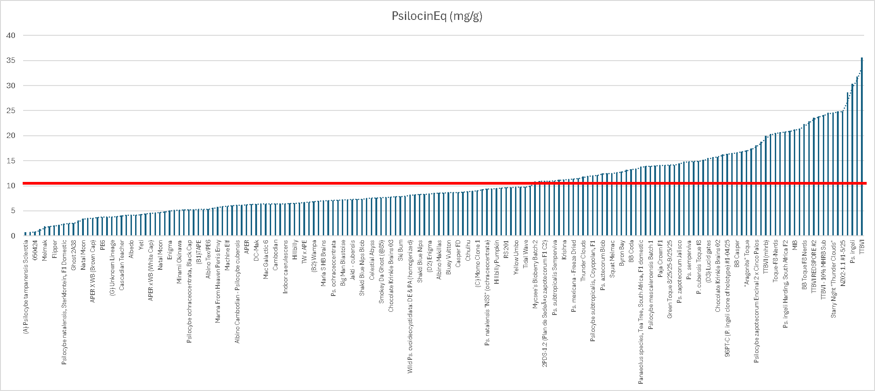
THE DATA VISUALIZED
Psilocin EQ = Psilocybin * 0.719 + Psilocin
Red Line = Avg Psilocin Eq = 10.45 mg/g

Slide 88
3RD COLORADO PSYCHEDELIC CUP AWARDS

